Slide 1

Bangladesh University of Business & Technology
PRESENTATION ON
pH Indicator With Auto Draining System
Presented By
Rajbir Ahmed (21225103170)
Md. Abu Sayem (21225103140)
Fahim Al Farid (21225103155)
Md. Shahariar Nabi (21225103164)

Slide 2
Introduction
pH Indicator With Auto Draining System is an automated system that indicates the pH value of stagnant water and drains the water with the motor as pH value. There are three draining motor which drains water respectively below pH 5 as acidic, upper pH 10 as base, and from pH 5.1 to pH 9.5 as neutral. It is mainly developed for agricultural uses as Bangladesh is an agrarian country. It is used for Fisheries and Cultivation of Crops because the acidic and base water is harmful to plants and animal.

Slide 3
motivation
Many areas in our country still do not have clean water. And even if water is available, many places do not know whether it is clean or drinkable. We want to do something to solve this problem. Our project is to inform the people whether the water is fit for drinking or use through this system and provide a clean water system. We also want to have a safer agricultural approach.

Slide 4
Objectives
To measure pH value.
To Use water as pH value.
To know the pollution level.
Drain the acidic and base water to a different chamber.
Drain the normal water into fish farming pond or into paddy field.
To save fisheries and paddy field.

Slide 5
EQUIPMENT
Arduino uno
pH sensor
pH sensor module
6v water motor
Motor Driver
LED
Resistor
Power supply converter
Power supply
Buck converter
10 k potentiometer
Switch

Slide 6
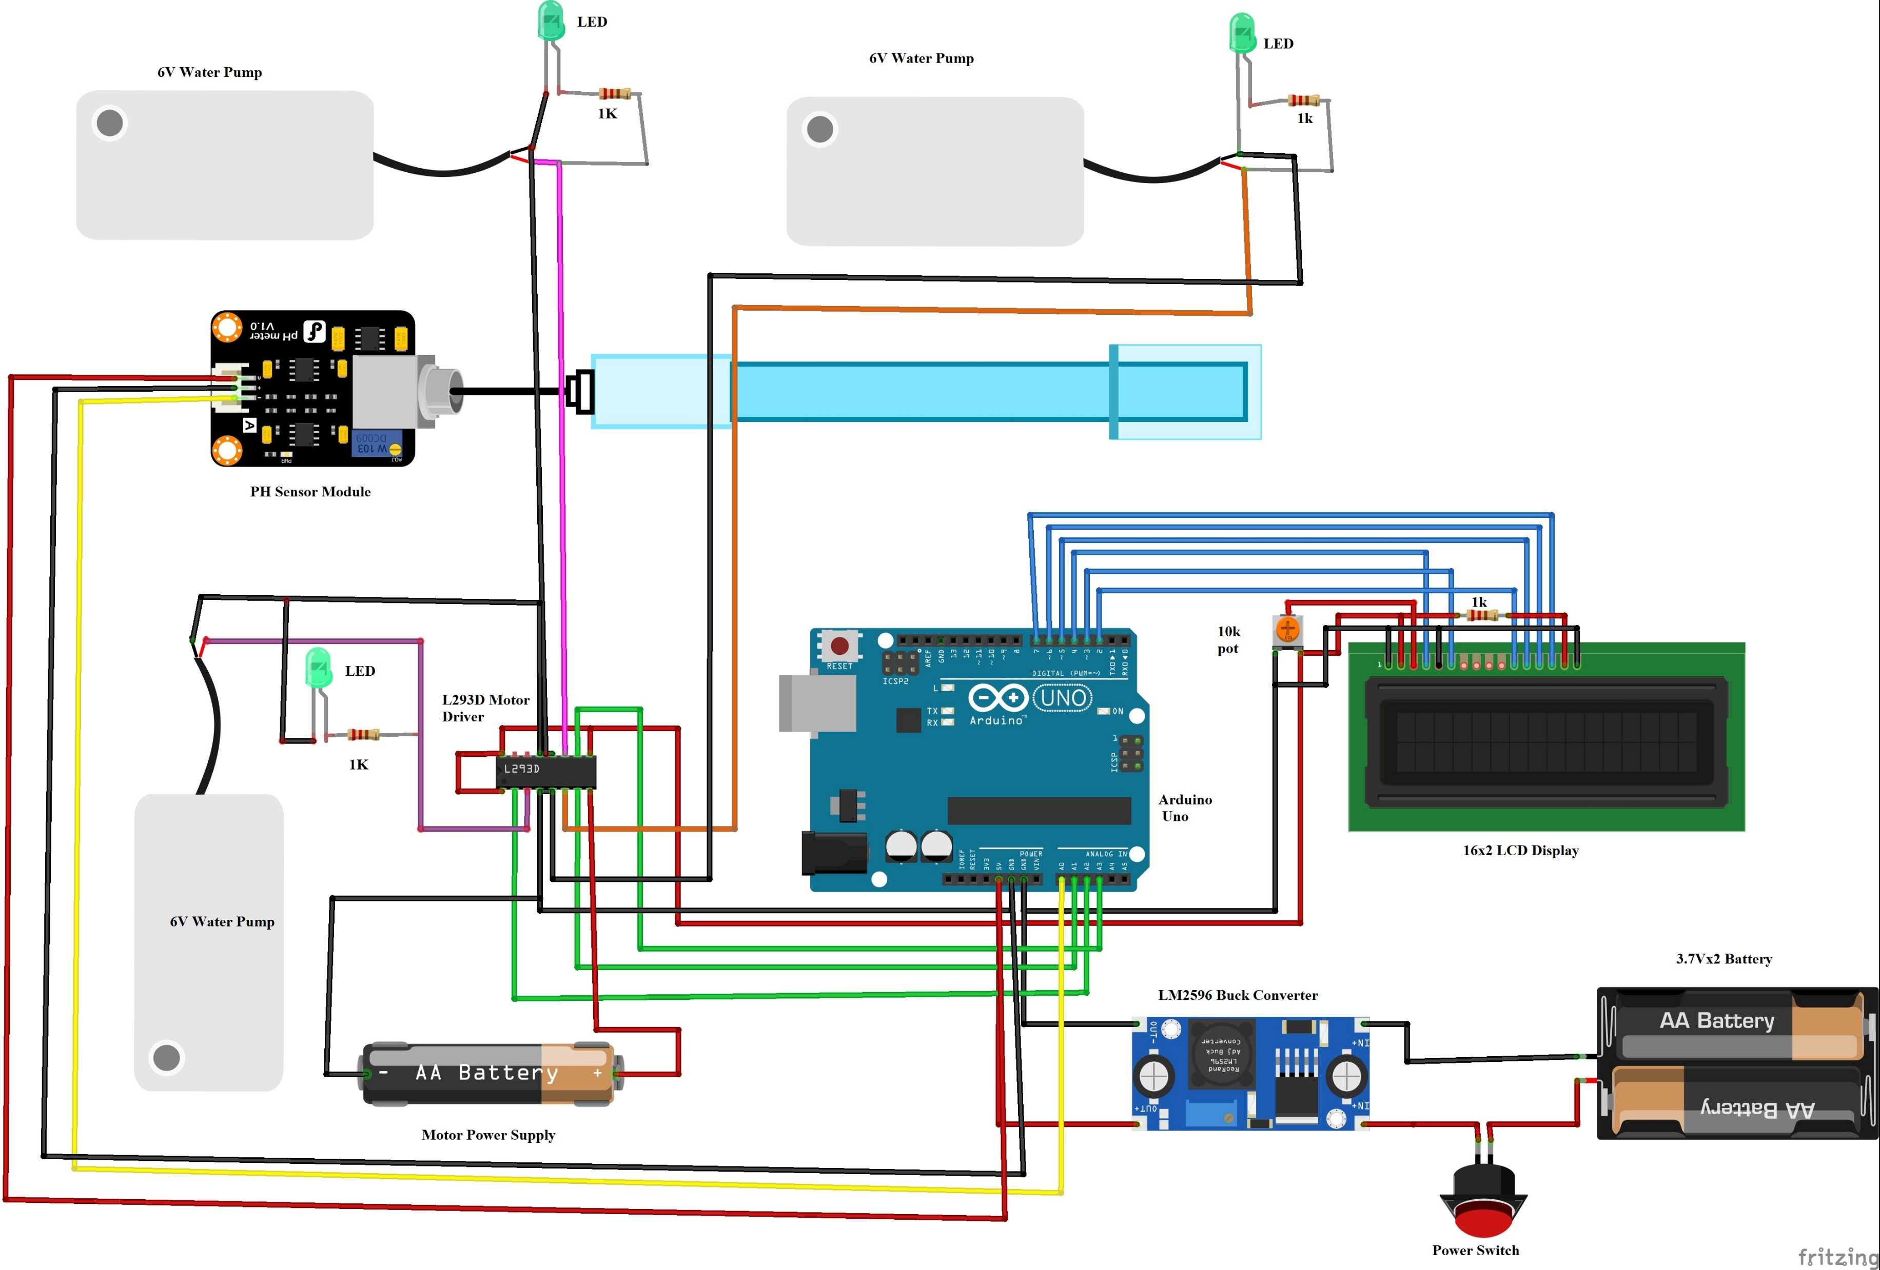
Diagram

Slide 7
Procedure
An Arduino Uno-based pH meter measures the acidity or alkalinity of a liquid solution using a gravity pH sensor. The pH sensor consists of a glass membrane rod filled with a buffer solution. When immersed in a liquid, hydrogen ions exchange with the positively charged ions inside the bulb. This creates an electrochemical difference, which the electronic amplifier interprets. The difference is then converted into pH units, and the pH meter sends the final pH values to the Arduino board. The Arduino Uno reads the analog output from the pH sensor. It processes this data and displays the pH value on an LCD screen or other output devices. Then the Arduino uno start the motor using the pH reading. Different motor starts on different pH value.

Slide 8
Future Work
We will work on if the water is dirty or not usable for normal work then it will be usable.
Add water depth measuring machine.
Add iron measuring machine.
Make a fully AI based software for this project.

Slide 9
Conclusion
In the conclusion we can say that our system is able to provide save water for living Being. It also help in agriculture like fisheries and paddy field. It also help to save our environment from pollution.

Slide 10
The end

